Slide 1
A Champion Approach
Attitude, Drills, Skills
Josh Regan
Fort Scott High School
jregan@usd234.org
620-288-6617

Slide 2
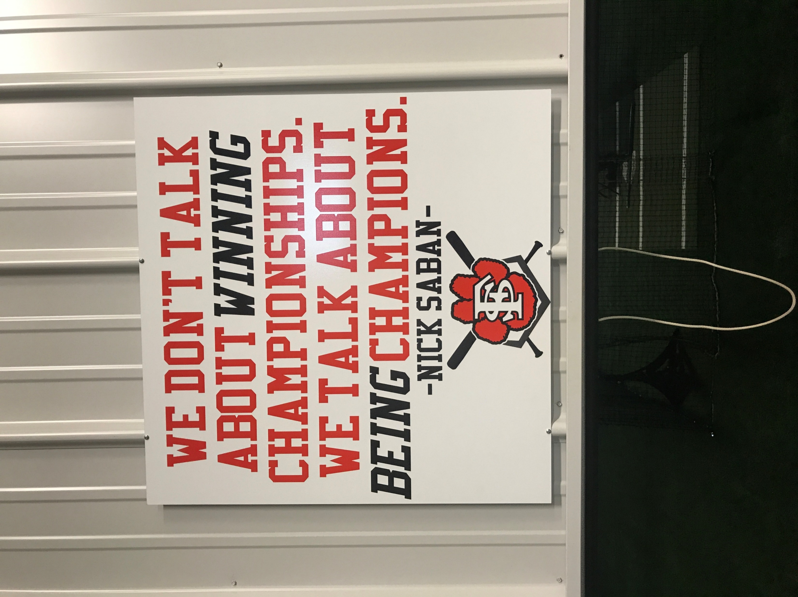
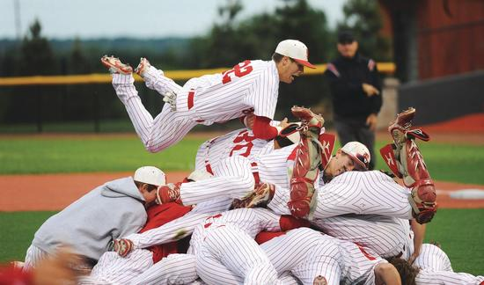
What is a CHAMPION?
Outcome? (Trophies)??
Or the “Process”?

Slide 3
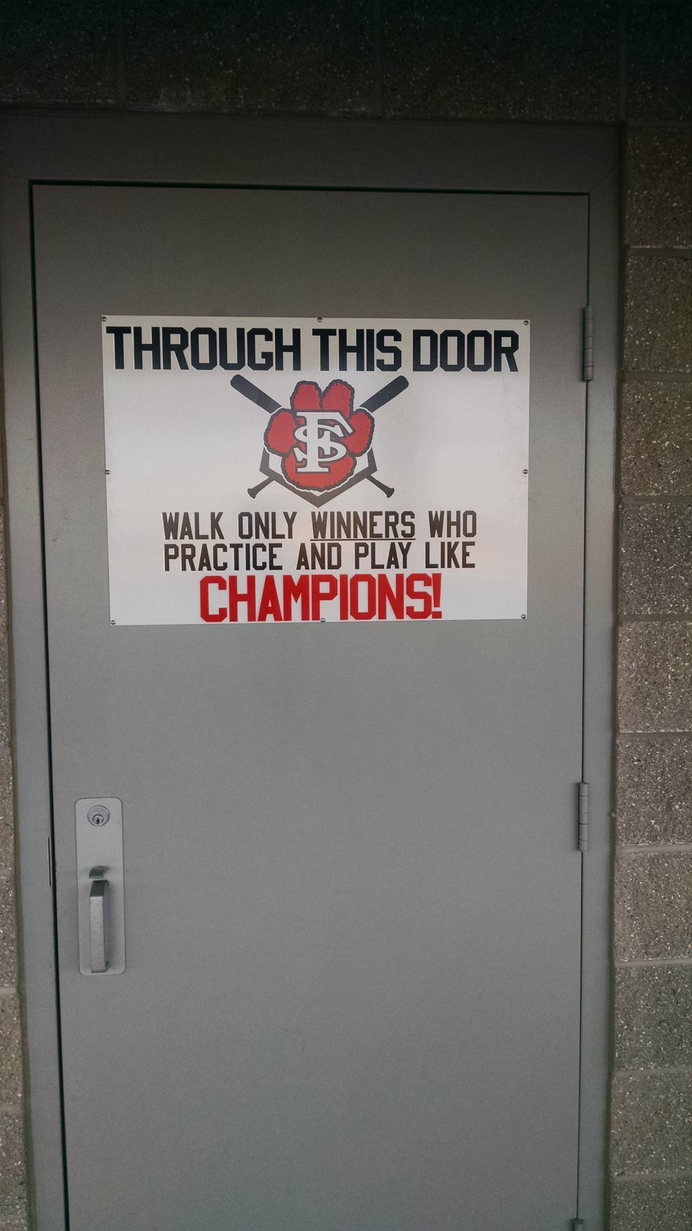
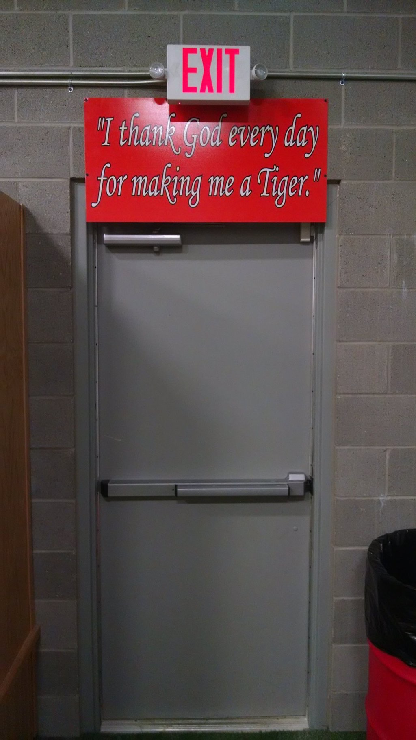
Establishing a Culture

Slide 4
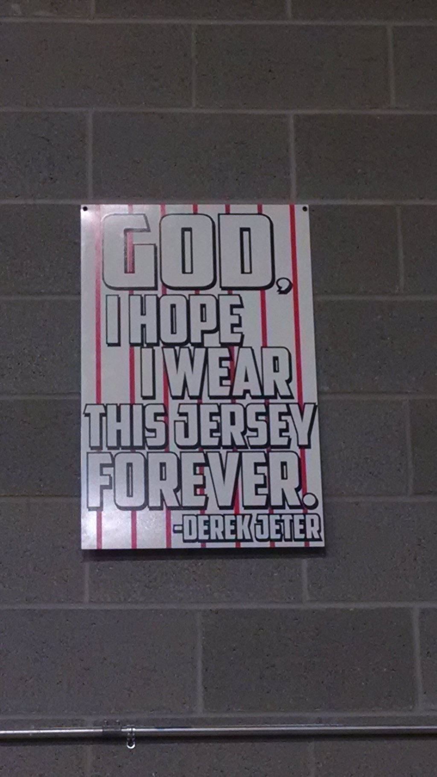
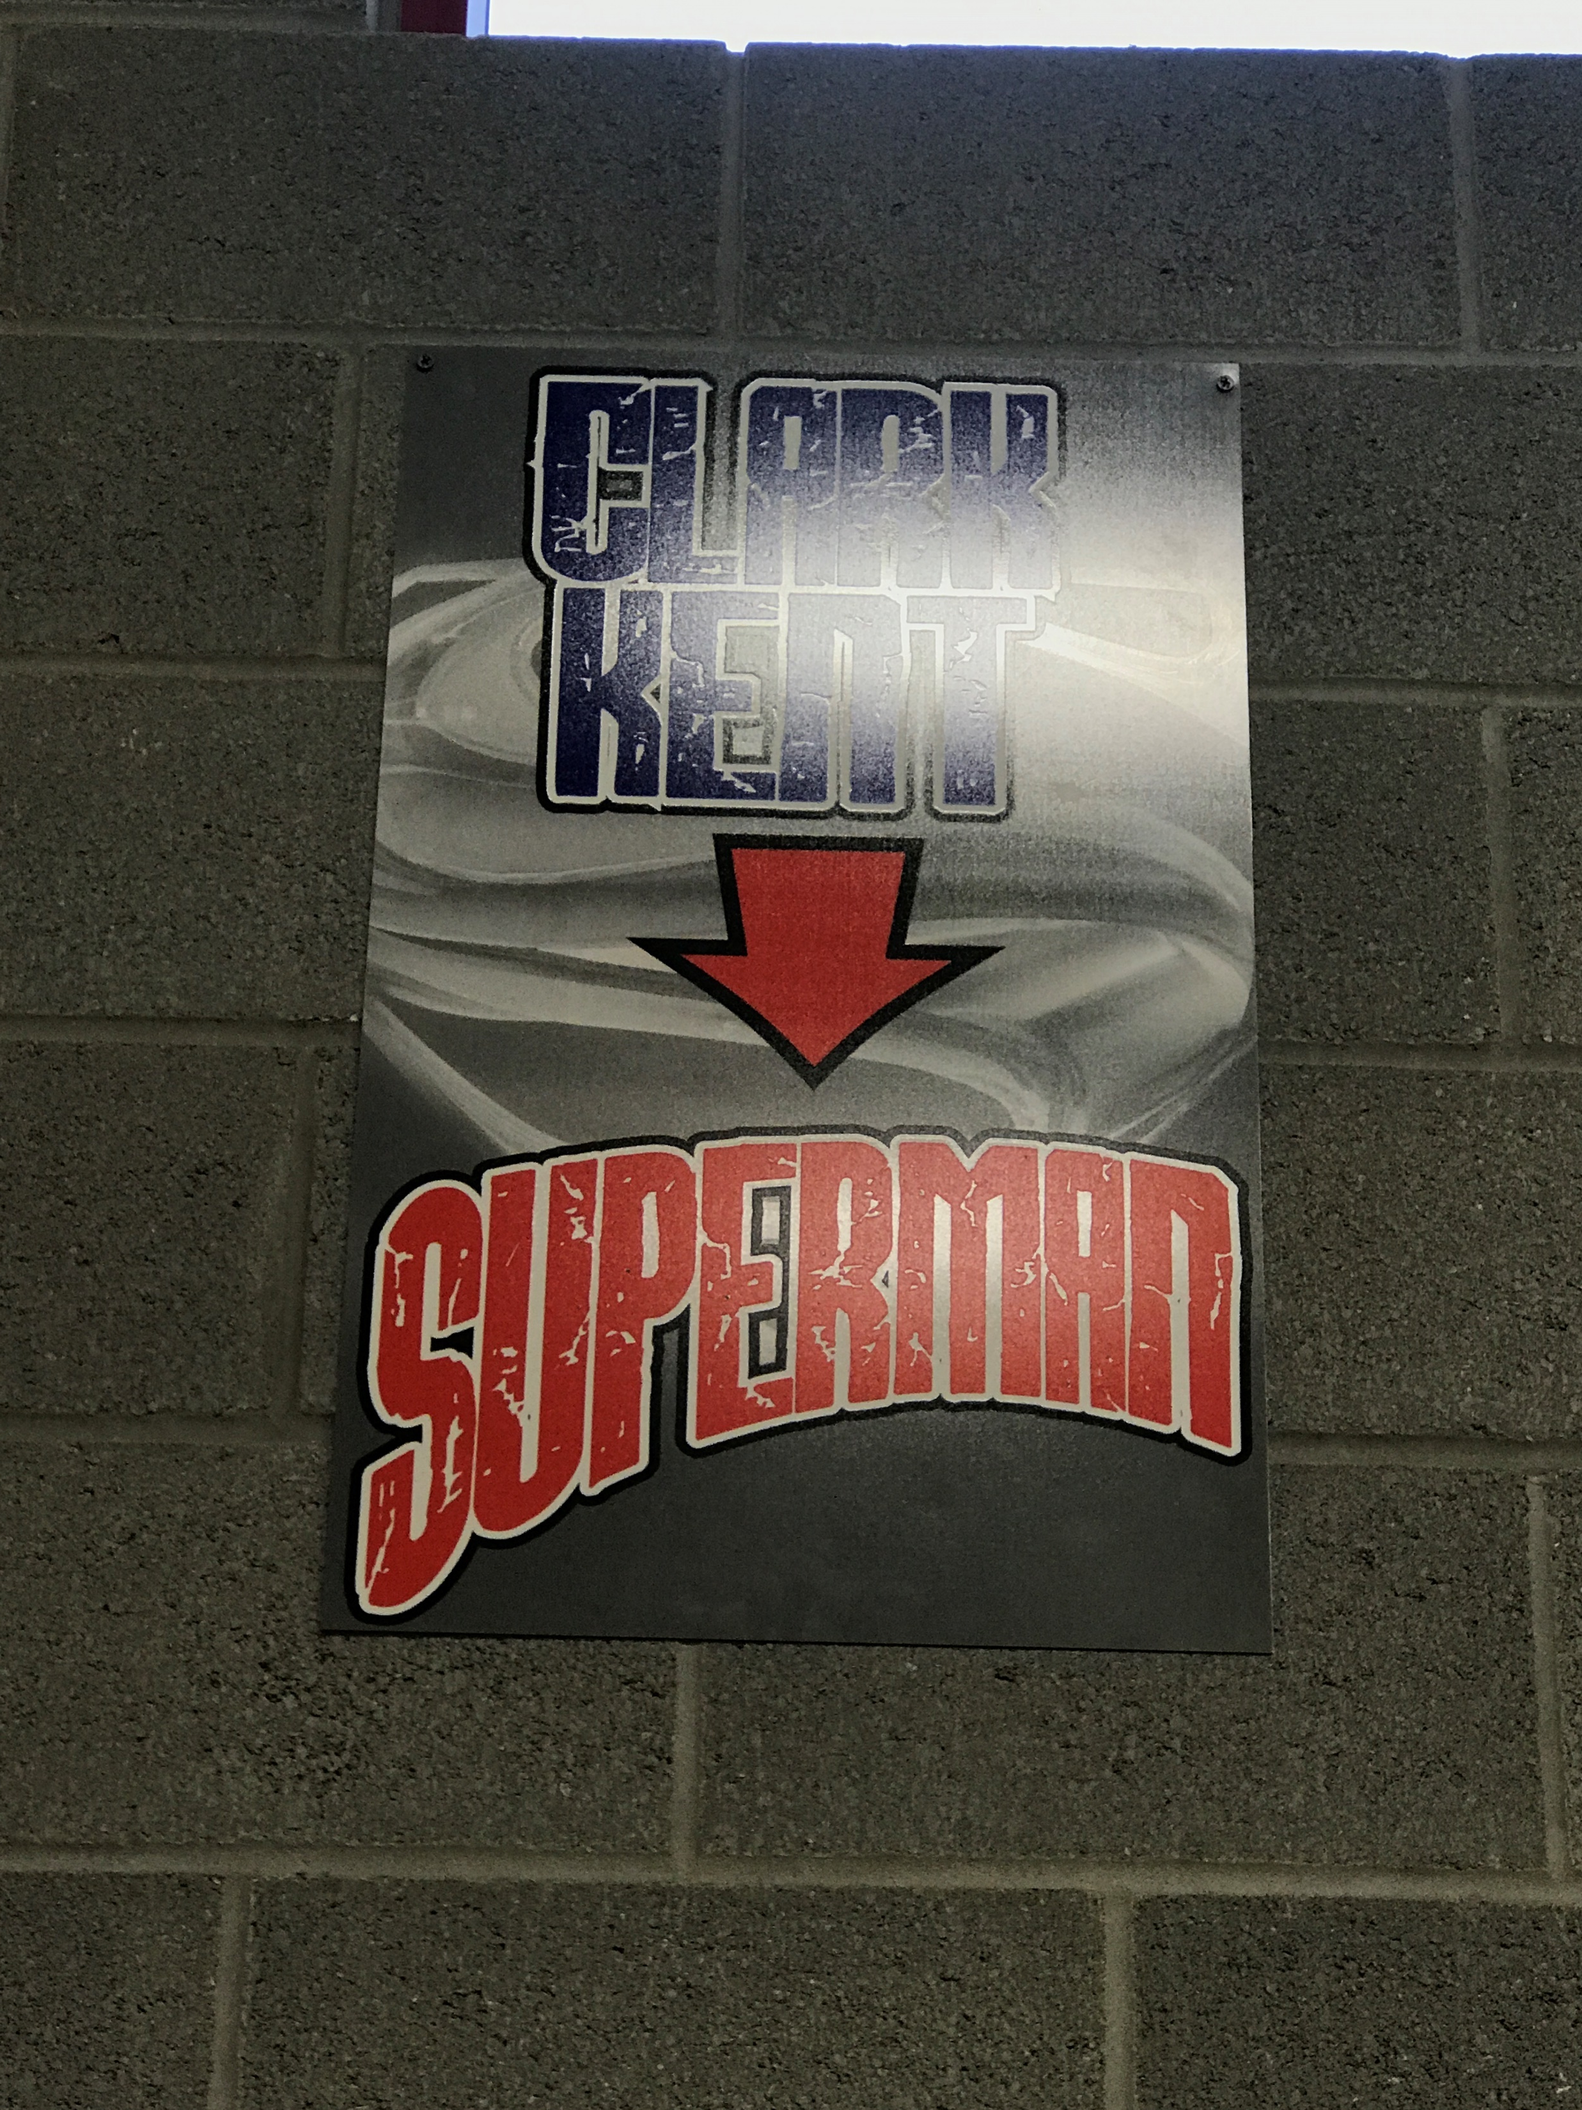
Establishing a Culture

Slide 5
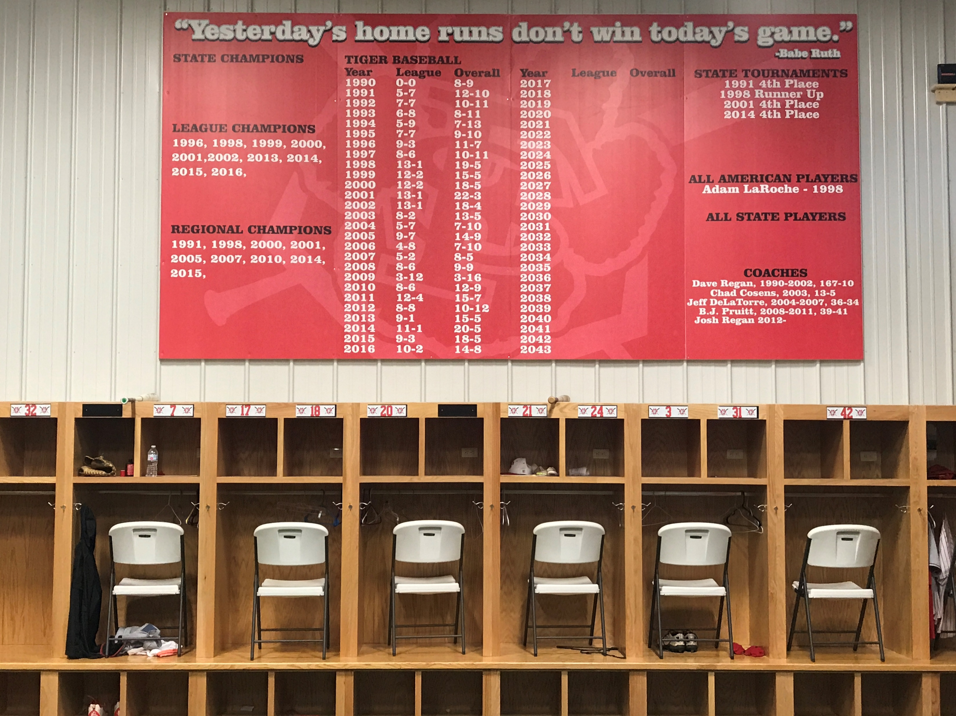
Establishing a Culture

Slide 6
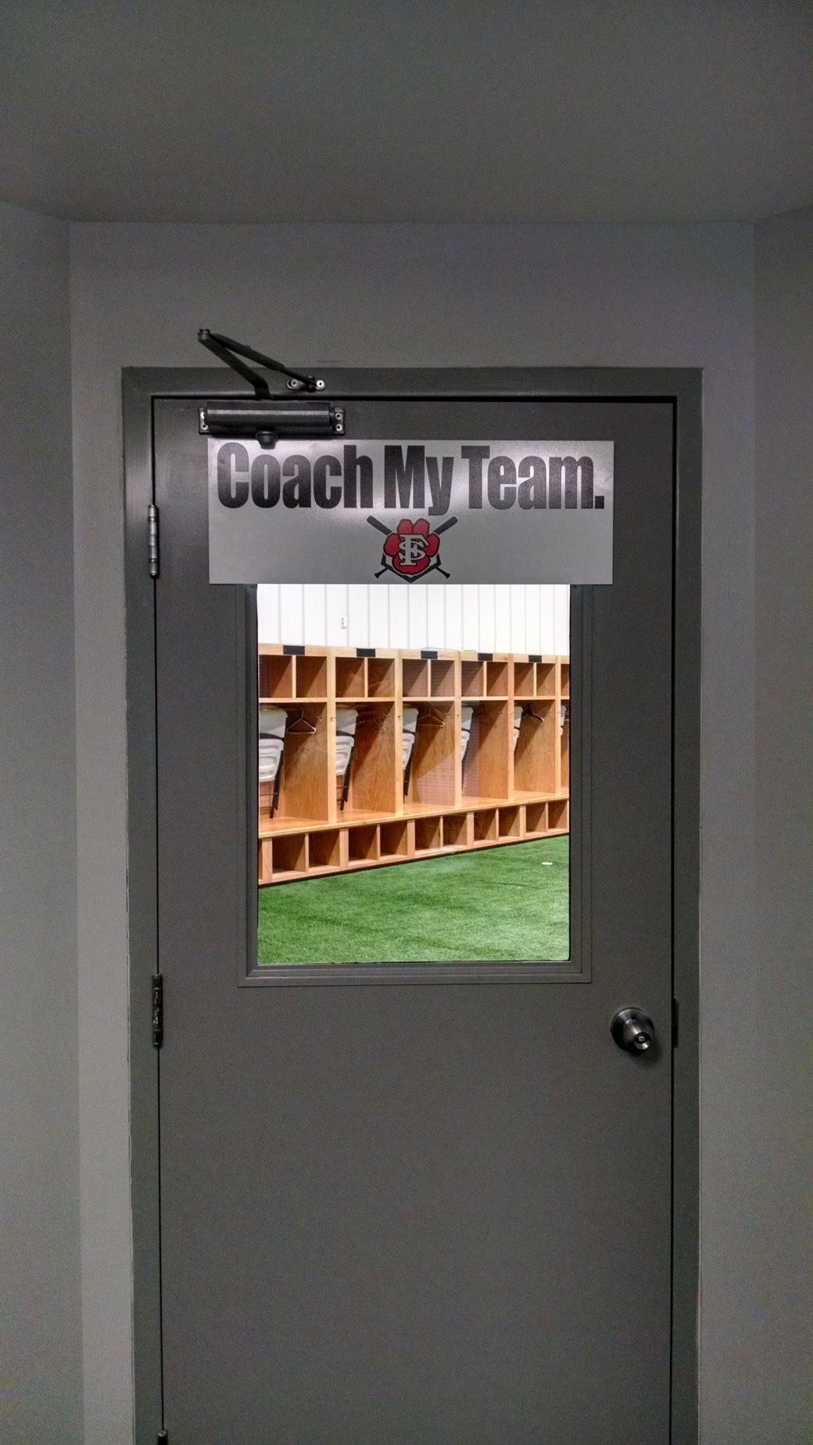
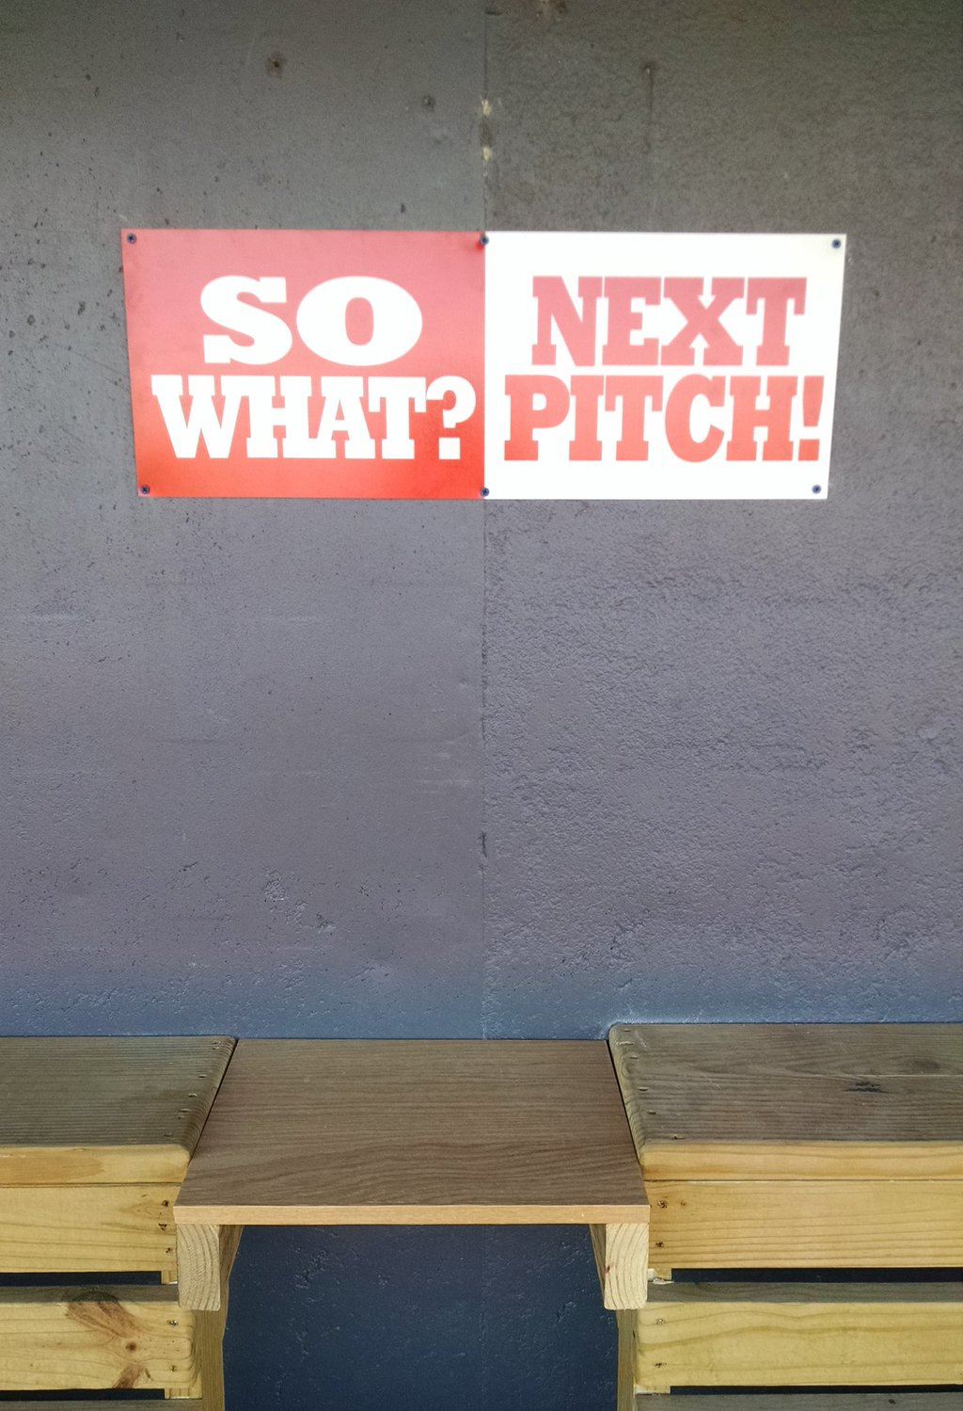
Attitude

Slide 7
Attitude
AGGRESSIVENESS
  “ATTACK MODE”
  Football- New Orleans and Alabama onside kicks on the biggest stage
    The bigger the game, the more aggressive you should be (sets the tone)
  Green Light 90% of the time, everywhere on bases- every player.
    You will find that your best base stealers are not your fastest players.
    Put PRESSURE on the defense
    SS, H&R, DS, BS, WL
    Rewards for going 1st to 3rd or Stealing 3rd- esp with one out.
    *You MUST be willing to live with guys being thrown out when it’s smart, aggressive move*
  Approach at the plate- Aggressive early (Be very aggressive or very patient)
    HUNTING Fastballs
    2-strike approach- No punchies looking
    Play for the big inning, especially early
  QAB’s- The only offensive stat that we measure and show
  A3P- The only pitching stat that we measure and show

Slide 8
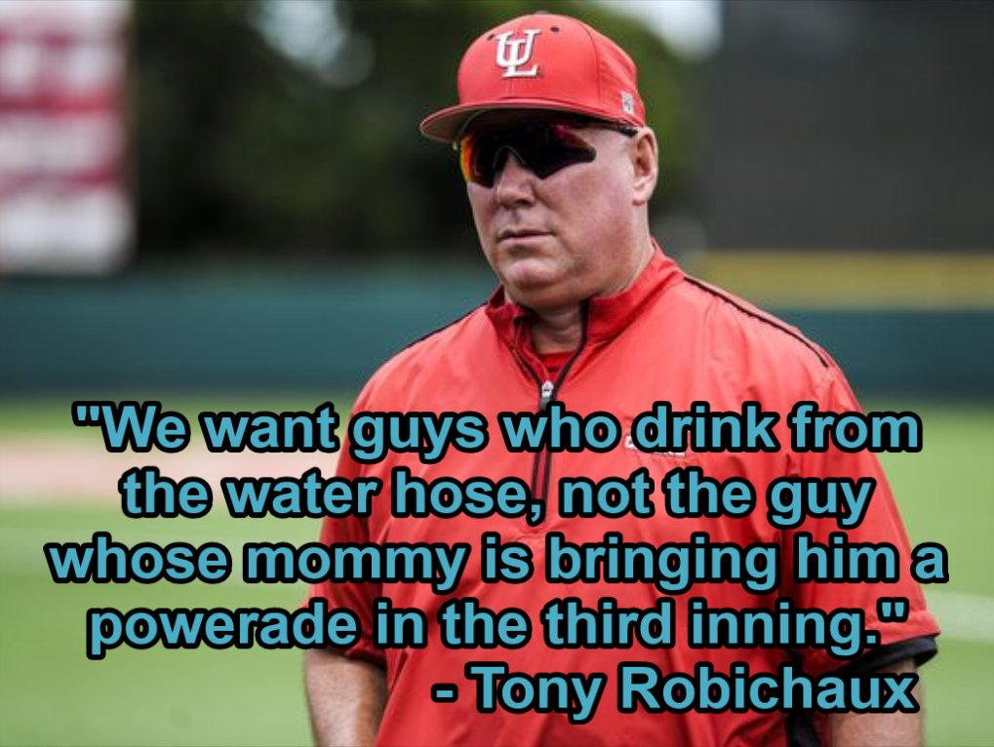
Attitude

Slide 9
Attitude
TOUGHNESS (MENTAL/PHYSICAL)
  Baseball requires a different type of mental toughness than other sports.
  Are we born with it, or can you truly develop it?
  I believe SOME can develop it.
    What we do is NOT for everyone.
  It has to be worked on DAILY- Garden Analogy
    1PW and Heads-Up Baseball concepts
      Ken Ravizza, Brian Cain, Justin Dehmer
    Routines- practiced throughout the daily workout
      QUALITY vs QUANTITY- Swings, GB’s, etc.

Slide 10
Attitude
Ownership/Mindfulness
  Nick Saban- Prioritizing what is best for the individual, not the team
How do Big-Leaguers…
  change for practice and a game?
  warm up?
  approach practice/games?
  execute drills and pre-game routine?
    Jack Wilson…
Teach them to OWN their routine, their work, their success, their failure!!!

Slide 11
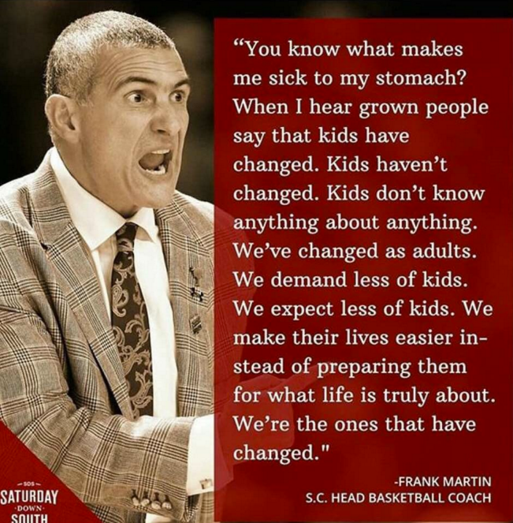
Attitude

Slide 12
Skills
Mental Toughness is a skill.
Competing is a skill.
Physical Toughness is a skill.
Focus/Concentration is a skill.
Poise under pressure is a skill.
The 5 tools are skills.
SKILLS CAN BE DEVELOPED AND IMPROVED!!
  Don’t be a hypocrite… own your own success as well.
  Complaining about the quality of your players is the sign of a poor coach!!

Slide 13
Skills
My #1 Paramount Goal
  For my players to COMPETE FEARLESSLY regardless of the stakes!!!
  This is a skill as well!!
  Do you chew on players after a physical mistake?? (Mental vs. Physical)

Slide 14
Drills- Base Running
Always a base running drill at the end of our form running- to activate muscles while also working on a skill.
  Base Running- “Special Teams”- needs to be emphasized. Teach them that this will win you games!!
  4 deep at bases to get more reps
    Walking lead steal @ 1st
    Stealing 2nd (jump and techniques)
    1st to 3rd- Reading OF
    Stealing 3rd (99% Green Light)
    Balk Steal- Runner @ 3 reads
    Double out of the box (Reading OF or throw if runner @ 2.)
    *Note- All of these encourage and require an AGGRESSIVE mindset*

Slide 15
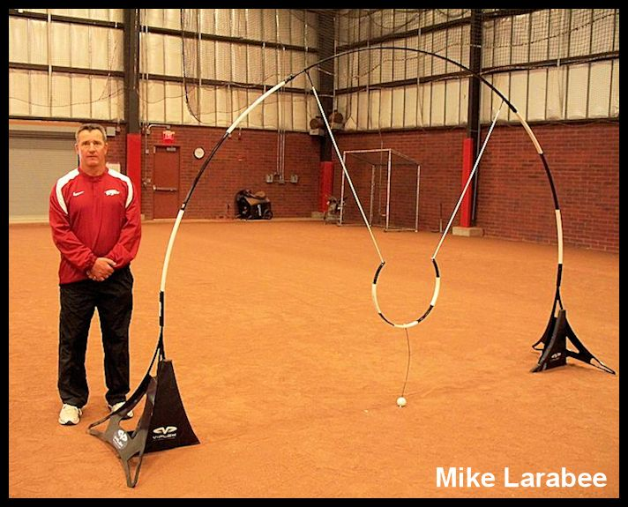
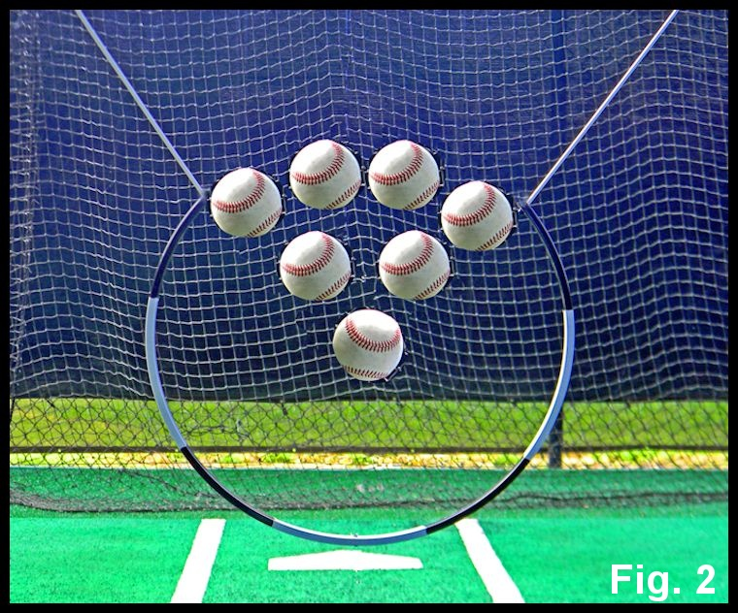
Drills- The V-Flex

Slide 16
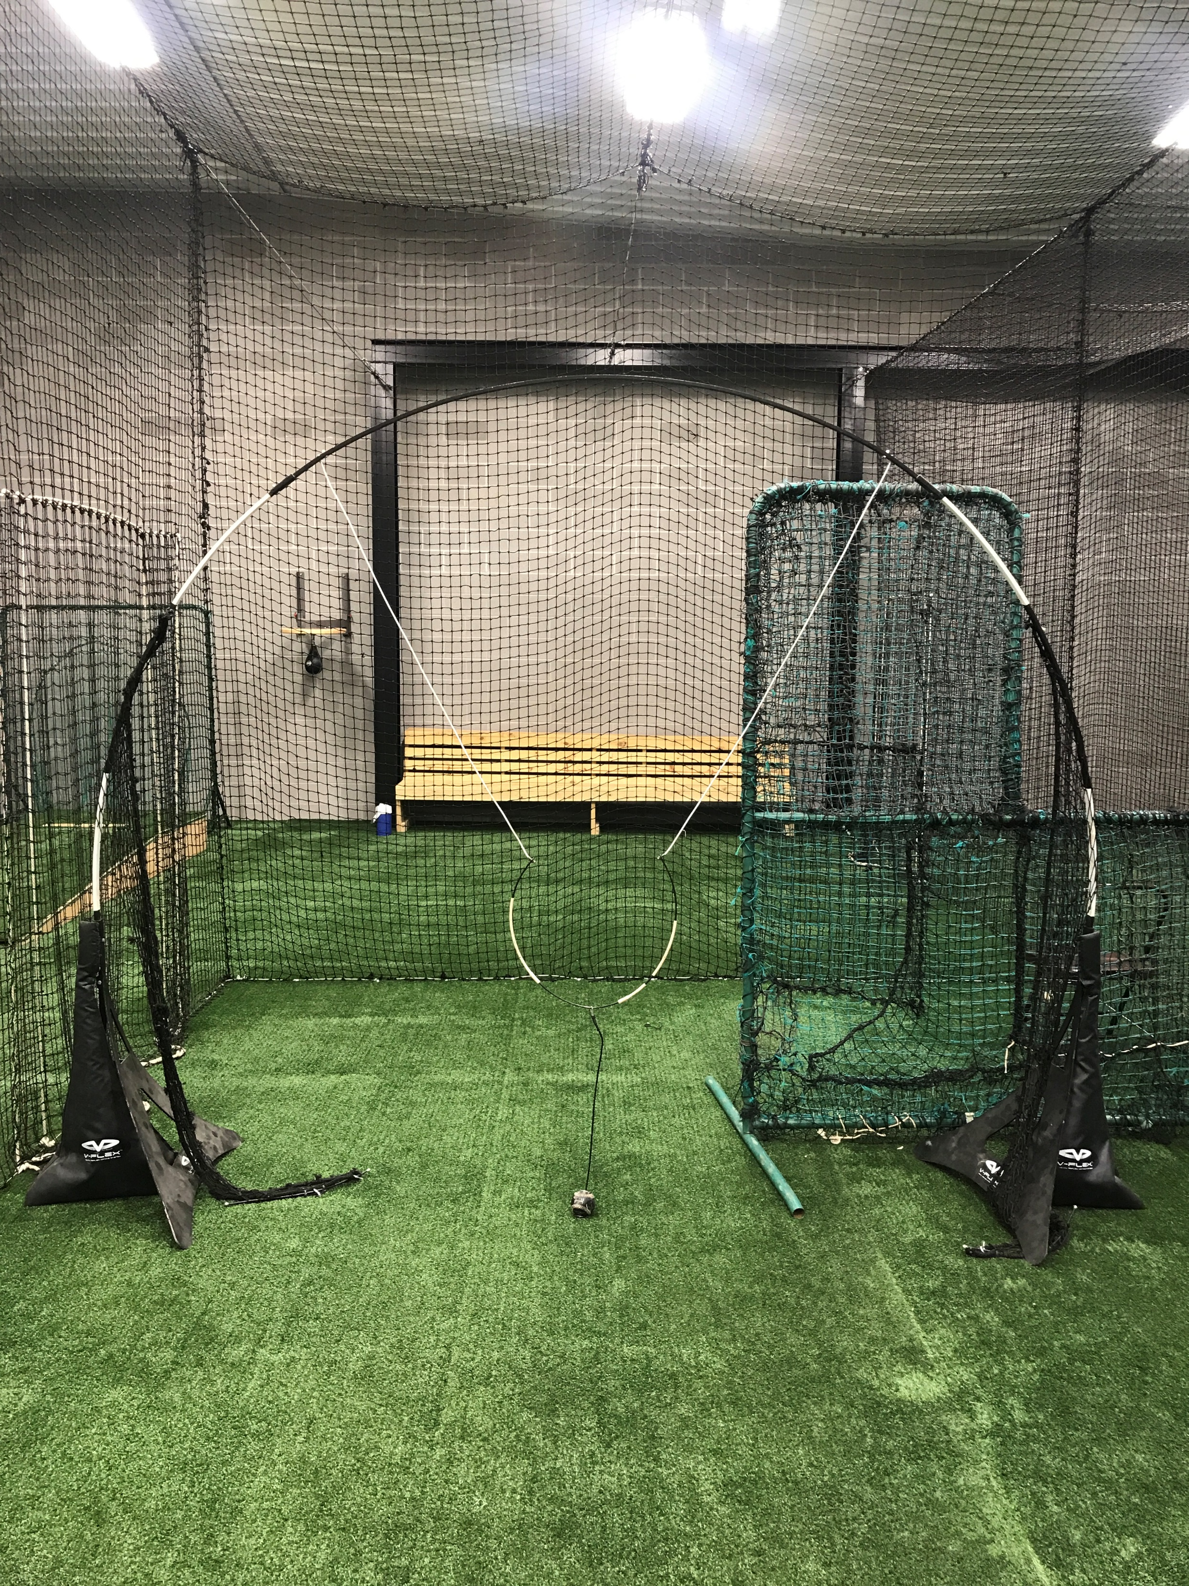
Drills- The V-Flex

Slide 17
Drills- The V-Flex
I have no idea how it works, but I do know that it works.
“Attack Mode”- HUNTING pitches out of the hand
  Goes right along with our offensive philosophy
Pitch Recognition- IMO only possible if you are hunting pitches

Slide 18
Drills- Use of Video
“The Inner Game of Tennis”- Timothy Gallwey
Players will BELIEVE it when they SEE it.
Hudl- Practice, games

Slide 19
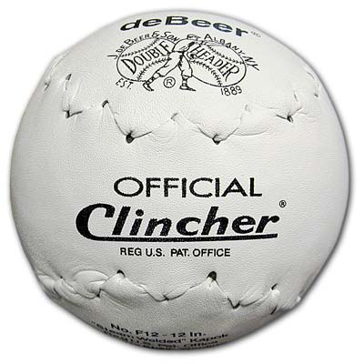
Drills- Hitting
DeBeers Softballs- available on Amazon if not through your equipment salesman
  Emphasis on LETTING IT EAT. (Aggressive)
  Hit them on the field… we play Homerun Derby w them.
  The harder you throw them, the harder they must swing.

Slide 20
Drills- Hitting
2-Strike Scrimmage (Aggressive Approach)
Line Drive Scrimmage (Control the Controllables)
3 Plate Drill (Making adjustments)
LIVE MATCHUPS!!– You can never have too many of these, especially in the preseason. (Compete, manage game pressure)
“Execution Rounds”- Bunt, H &R, Score from 3rd, Suicide Squeeze- then they get their swings. (Managing pressure)
Scoring BP (Competing)

Slide 21
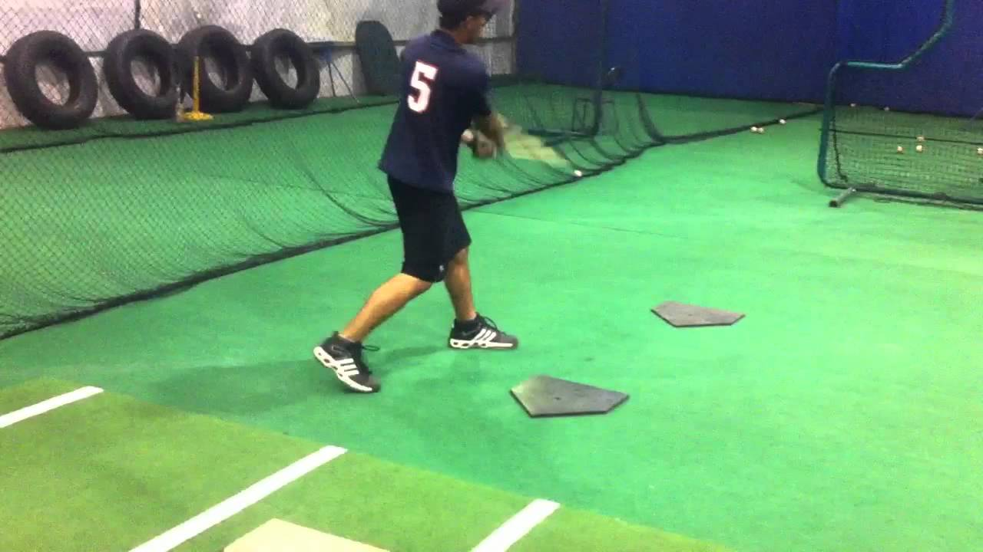
Drills- Hitting- 3 Plate Drill

Slide 22
Drills- Defense
Progressions- 1-3 times per week
  Position-Specific Fundies
    Development of glovework/footwork will surprise you if you isolate the movements
Establishment and Development of Pre-Pitch Routine
Establishment and PRACTICE of routine to move past a mistake
  Role Playing- Establishing the right way to react.
VISUALIZATION- Opportunity to plan their reaction to different game situations
  This helps tremendously!!
Live Defense during BP- Any loafing gets Dice.
“21 Outs”
  Provide opportunities for them to come together, and leaders emerge, after failure
“Perfect Once” or “Perfect Twice”
“Knockout”
*Create pressure situations in practice and teach them how to deal w/ it.*

Slide 23
Drills- Defense
IF Progressions
  “Shorties”- Short hops from 10-15 fee (1-handed)
  “Get-Arounds”- Use a bucket/cone
  “Backhands”
  “Forehands”
  “V-Cut”- Attack arm-side of baseball then work through
  “Slow Roller”- not practiced enough typically
Catchers’ Progressions
  Framing
  Blocks- Right/Left (with softies)
  Scoop/Throw- 2nd/3rd
  Transfer only
  Transfer/Throw- 2nd/3rd (short)

Slide 24
Thank you for the honor of speaking to you!
Never underestimate the power of what you do everyday.

